Slide 1


Content Analytics for Social Buzz

Slide 2


Today's agenda
Project recap
Problem
The Analytics team
Process
Insights
Summary

Slide 3

Social Buzz is a fast-growing technology unicorn that needs to adapt quickly to its global scale. The company has begun a 3- month POC focusing on these tasks:
An audit of Social Buzz’s big data practice.
Recommendations for a successful IPO.
Analysis to find Social Buzz’s top 5 most popular content categories.
Project Recap

Slide 4

Problem
Over 100,000 posts per day
36,500,000 pieces of content per year!
How to capitalize when there is so much?

Slide 5



The Analytics team

Slide 6
Process
1
Requirement Gathering
2
Data Cleaning
3
Data Modelling
4
Data Analysis
5
Content Insights

Slide 7

Insights
Most popular content with highest viewers is from Miscellaneous and Healthy Eating category.
Top 3 most positive sentiment contents -healthy eating, cooking and studying category.
Most negative is from the “travel” category.
5 out of 10 most posted content are from veganism, food, cooking categories)
667 reactions with content of “Travel”
Jan 2021 with highest no. of Content posted per month
Total 17 Unique Categories (including Miscellaneous)

Slide 8
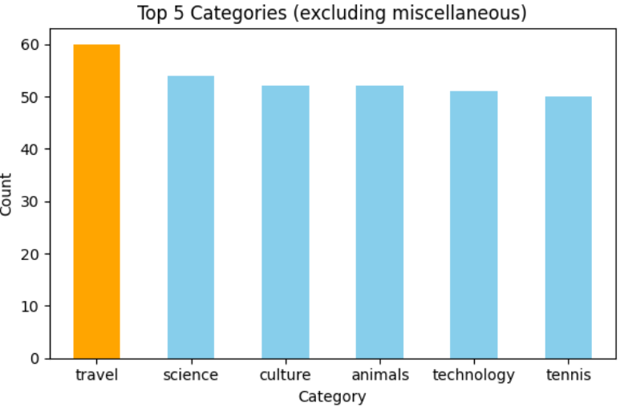
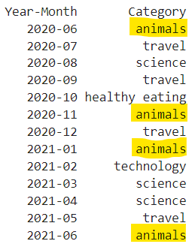

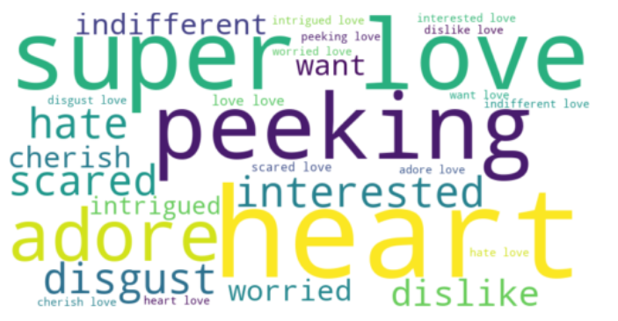
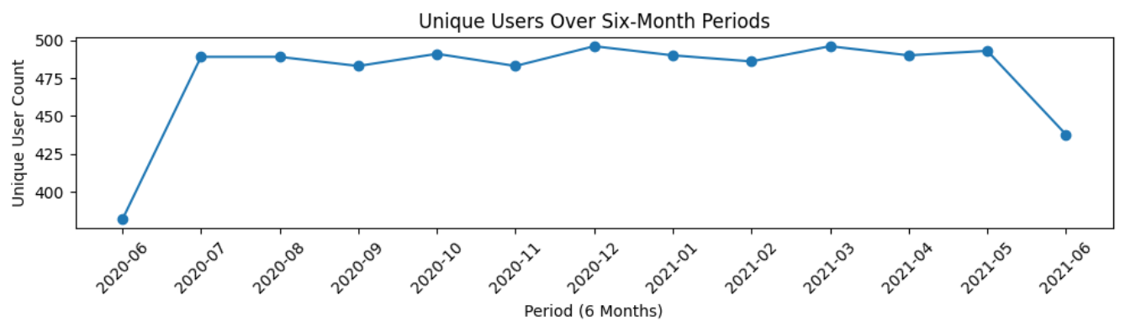
“Animal” turned out to be the most popular Category in 4 months.
“Peeking” turned out as most used reaction

Slide 9
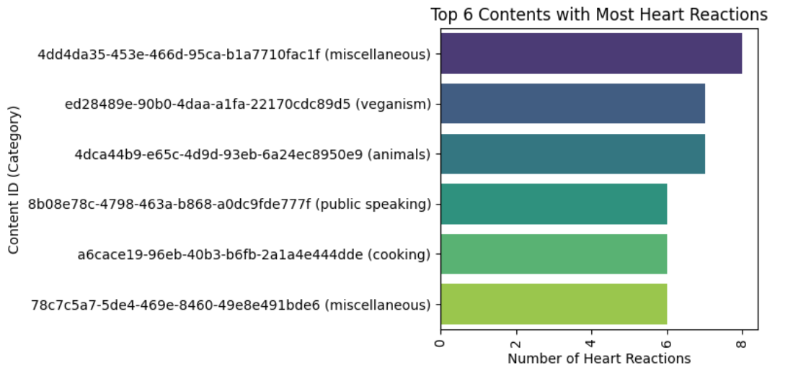

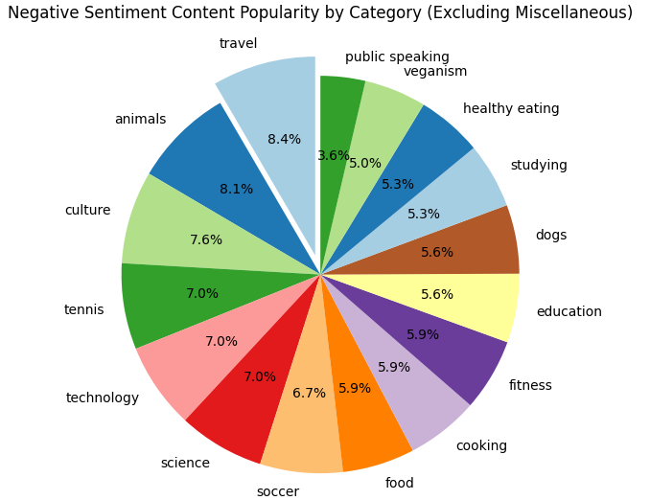
Miscellaneous
Veganism
Most loved posts are from categories
Animals
In negative sentiment “Travel” category has the highest popularity with more negative engagement to the posts.

Slide 10

ANALYSIS
Travel, Culture, Animals, and science are the most popular categories of content with travel being popular in a negative light, showing that people enjoy “real-life" and “factual” content the most.
INSIGHT
Food is a common theme in the top 10 categories with “Veganism" ranking the highest.
This may indicate the audience within your user base. You could use this insight to create a campaign and work with healthy eating brands to boost user engagement.
NEXT STEPS
This adhoc analysis is insightful, but it’s time to take this analysis into large-scale production for real-time understanding of your business. We can show
you how to do this.
Summary

Slide 11
Thank you!
ANY QUESTIONS?

